Slide 1
HCL STARSCHEMA workshop
Corvinus
Data Science orientation
Notes:
https://awoiaf.westeros.org/index.php/Westeros

Slide 2

Agenda, Setup
The context of the workshop
Theory – regression models
The backstory
You form heterogeneous teams. you will need some coding skills, some economy theory, some data science theory - we present what is needed today - so choose your team members wisely.
Personas and datasets.
Teams draw a persona with related goals and then work on solving the problem.
Teams summarize the findings in a presentation –designate a speaker to present the results (Template is provided)
The jury announces the final results.

Slide 3
Context
You will apply data science skills to a „real world” problem; in our case it will be a regression model.
You will derive, how the original problem can be addressed and how the processed data set can be used to answer the questions
Finally, you need to present and explain your findings and the solution
Each team will have a separate persona who has a specific goal and some questions.
You are free to redefine / complete the questions as long as you can contribute to reaching the goal

Slide 4
Theory
Regression models
Intuition
Specifics
Evaluation
The process

Slide 5
Backstory
Westeros is cool! The 9 great houses are still there, but there has been peace all around the world for eons. Dragons are tamed, and different kinds of sport replace fighting for real. People live healthy and prosperous lives, access to education is commonplace, and technology innovation through the development of transportation, IT and communication fueled economic growth.
A team of young Essos citizens embark on an adventurous journey in Westeros to explore the possibilities of the continent.
Breyna is an influencer, who regularly vlogs about her journeys. Her followers are numerous. Her goal is to maximize profit and influence. (Her revenue and influence is proportional with the population and rating of the town she stays at.)
Alberet is an enthusiastic dragon trainer organizing dragon „fights” – calm down, this is just a sport! His goal is to reach as many spectators as possible, and make a decent profit (1% of the folks will visit the show eventually).
Decran is a spy, who is disguised as a musician organizing festivals. His goal is to organize a music tour next year for younger folks and as an undercover agent to also visit all major eastern ports to investigate their vulnerabilities.
Ayenna is the broadcasting producer of the 4-yearly Westeros Football Cup (9 teams, 9 matches, 18 days). Her goal is to maximize the ad revenue (porportional to the population of the match city) and minimize the accomodation cost of the crew of 12.
Edlin is an avid tourist. His goal is to visit as many places as possible, while spending at least one night in a certain place.

Slide 6
personas
Your team selects one character, and work on helping the person achieve their goals.
You have:
A Regression task
4-6 Simple Questions (3 should be answered as a minimum)
A Complex Question (WDYT: „What do you think”), where you have to use your evaluation and analytical skills
You have the liberty to specify details we did not provide, but be reasonable – the Jury will have the final decision!

Slide 7
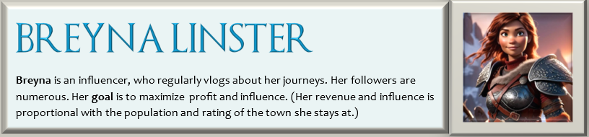
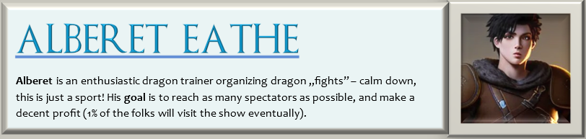
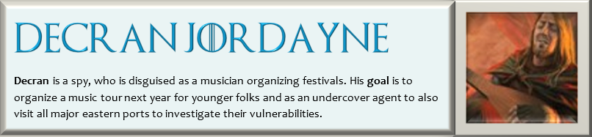
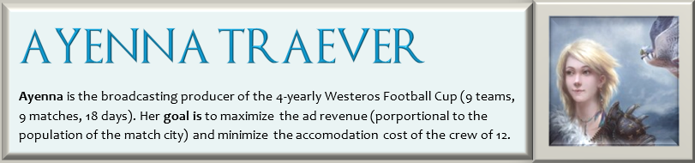
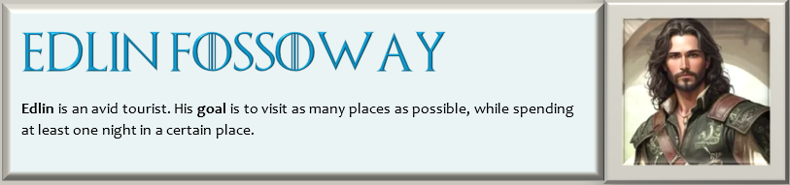
personas

Slide 8
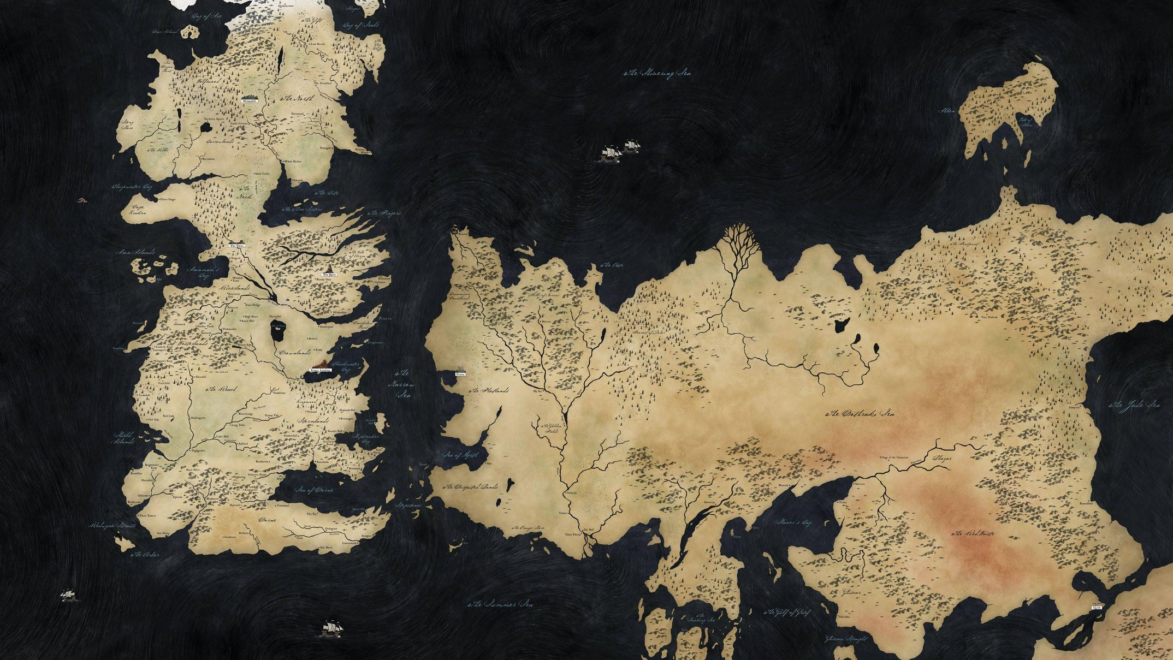
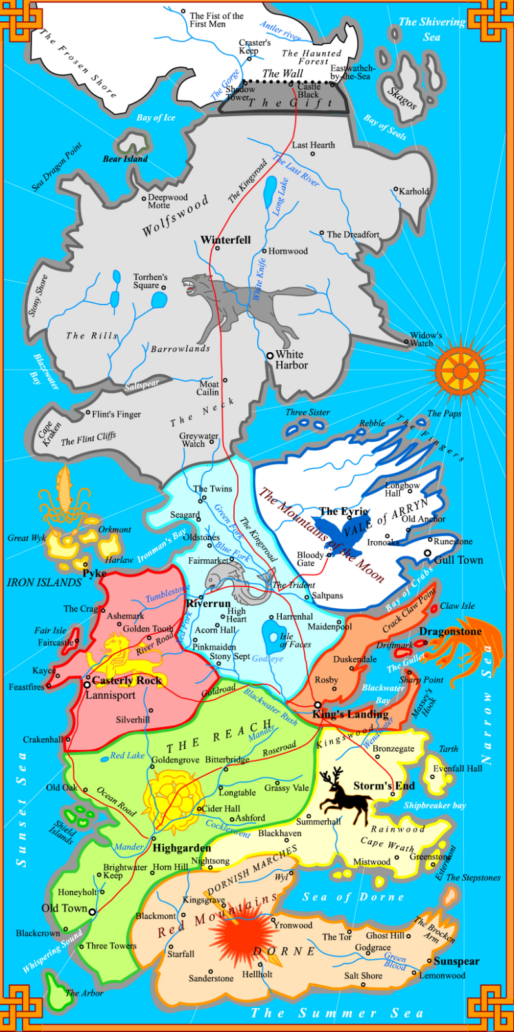
The known world

Slide 9
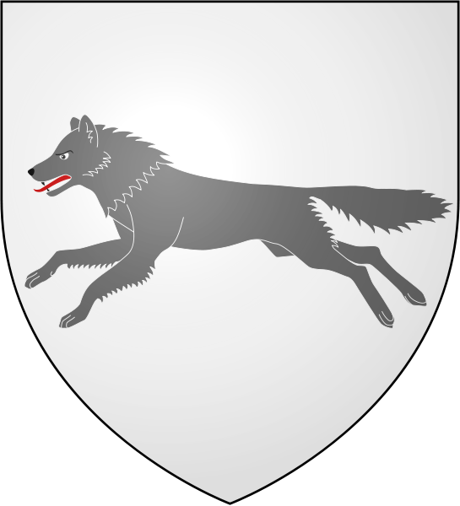
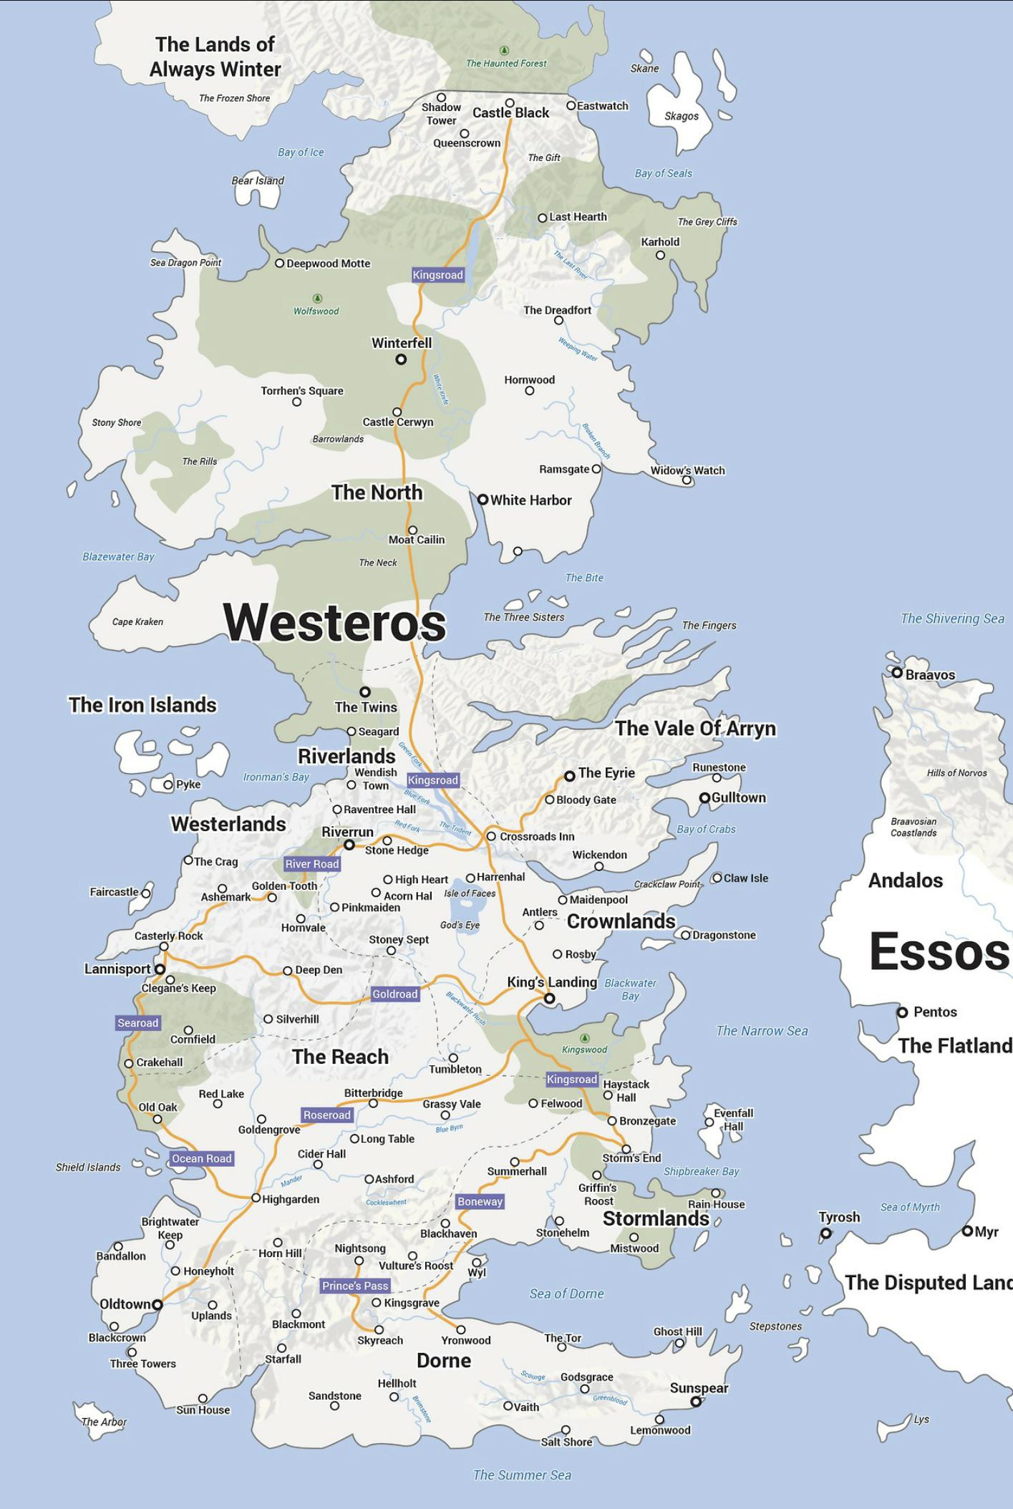
The North House Stark of Winterfell

Slide 10

The Iron Islands House Greyjoy of Pike

Slide 11

The Riverlands House Tully of Riverrun

Slide 12

The Vale of Arryn House Arryn of the Eyrie

Slide 13

The Westerlands house Lannister of Casterley Rock

Slide 14
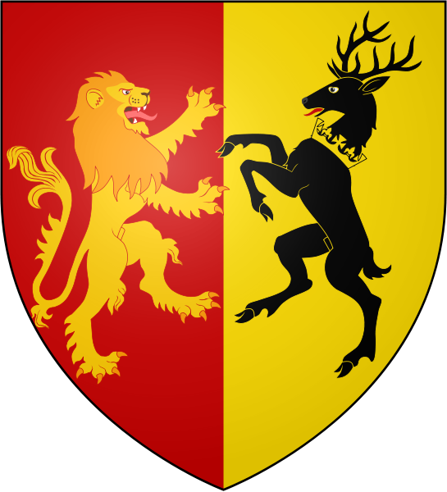
The Crownlands House Baratheon of King’s Landing

Slide 15
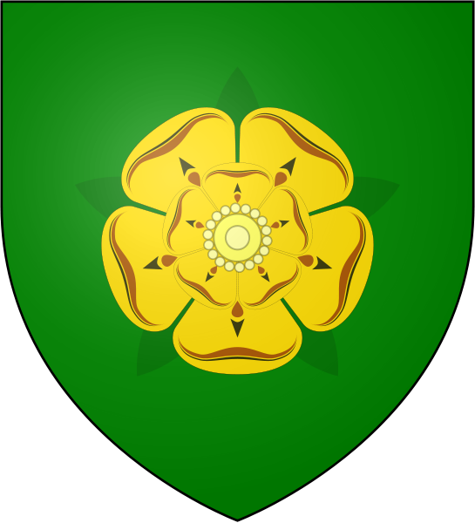
The Reach House Tyrell of Highgarden

Slide 16
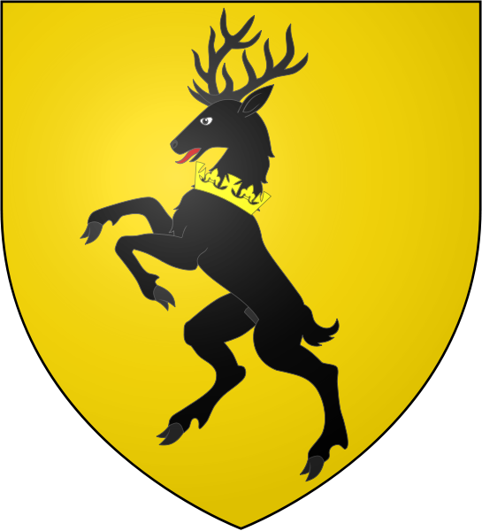
The Stormlands House Baratheon of Storm’s End

Slide 17
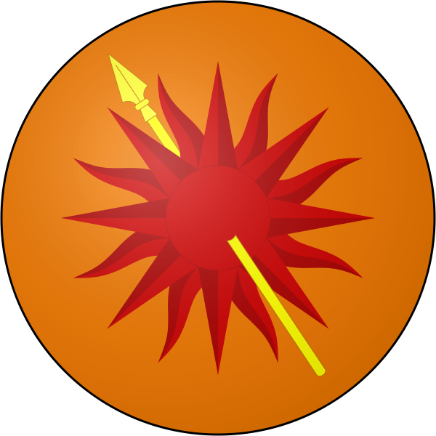
Dorne House Nymeros Martell of Sunspear

Slide 18
City list
Region | Capital | Important cities
The North | Winterfell | White Harbor, Widow’s Watch, Karhold, Flint’s Finger
The Iron Islands | Pyke | Harlow Port, Orkmont Villa
The Riverlands | Riverrun | Seagard, The Twins, Maidenpool, Stony Sept
The Vale of Arryn | The Eyrie | Gull Town, Runestone, Ironoaks, Longbow Hall
The Westerlands | Casterley Rock | Lannisport, Crakenhall, The Crag, Silverhill
The Crownlands | King’s Landing | Dragonstone, Sharp Point, Duskendale, Rosby
The Reach | Highgarden | Old Town, Three Towers, Old Oak, Longtable
The Stormlands | Storm’s End | Greenstone, Nightsong, Bronzegate, Summerhall
Dorne | Sunspear | Yronwood, Starfall, Hellholt, Godgrace

Slide 19
Presentation template

Slide 20
Problem

Slide 21
questions

Slide 22
Model creation (opt)

Slide 23
findings

Slide 24
recommendations

